Slide 1
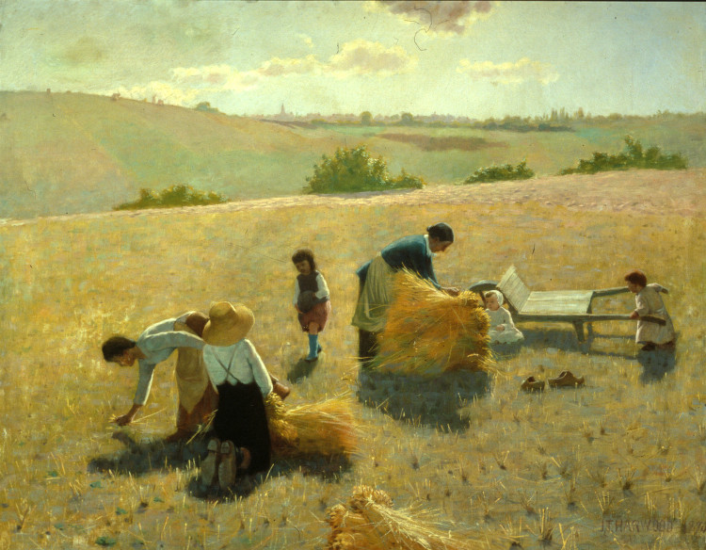
Gardening 101
“And it came to pass that they began to spread upon the face of the land, and to multiply and to till the earth; and they did wax strong in the land.” Ether 6:18

Slide 2
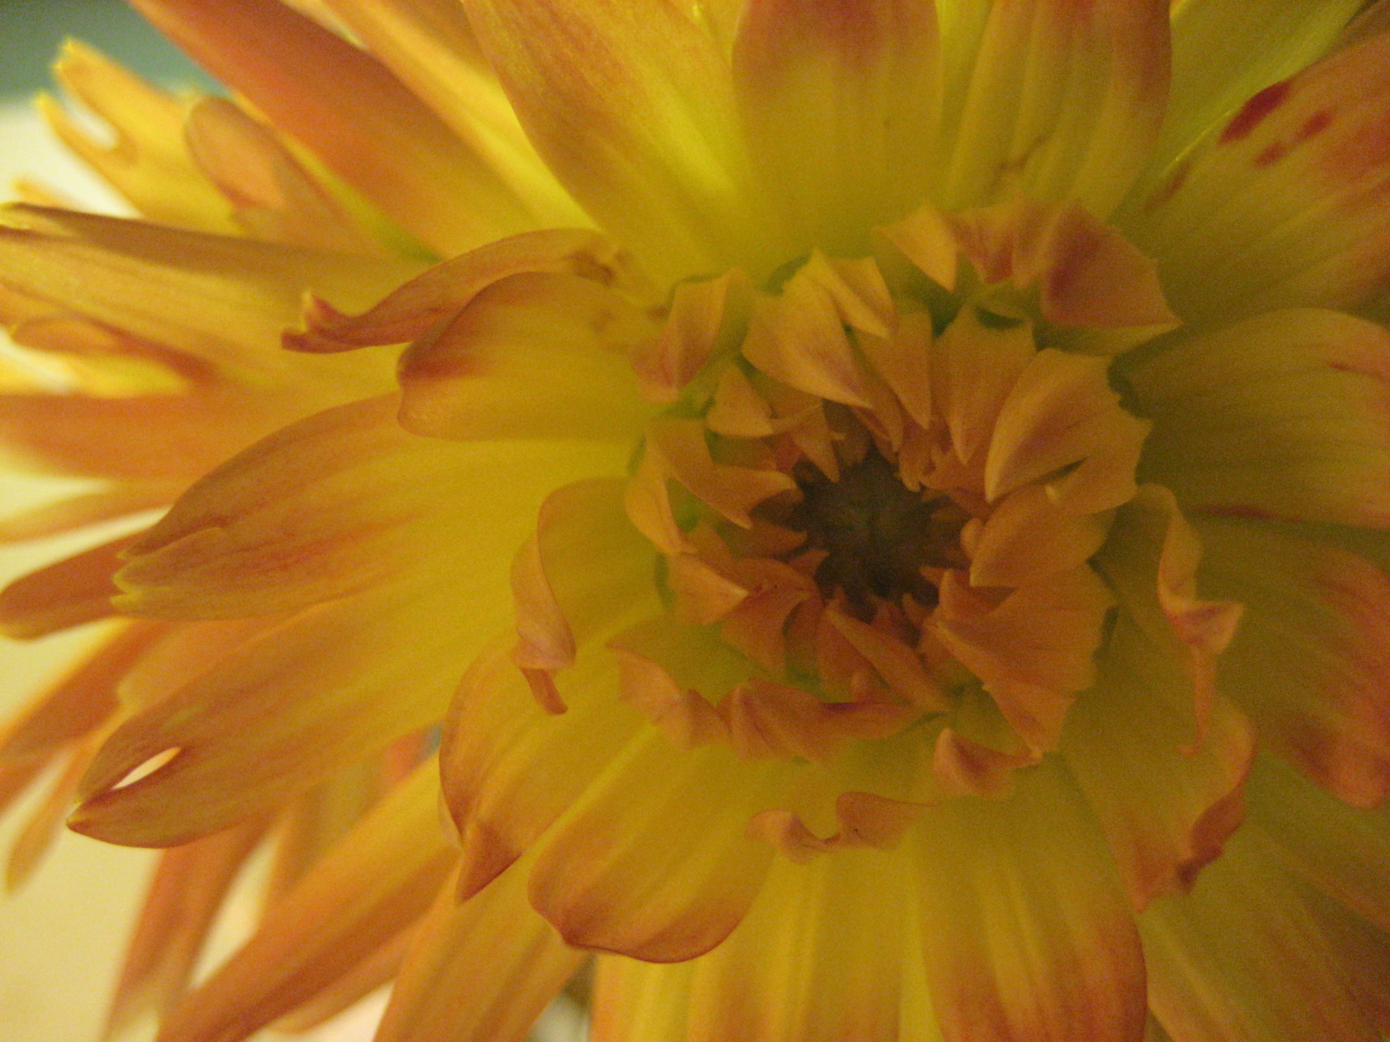
Gardening 101
Begin with a Plan
Where to Plant
What to Plant
When to Plant
Prepare the Garden Site
Plant the Garden
Tend the Garden
Water
Mulch
Cultivate
Control Insect Damage
Harvest Crops
Prepare for Next Year

Slide 3
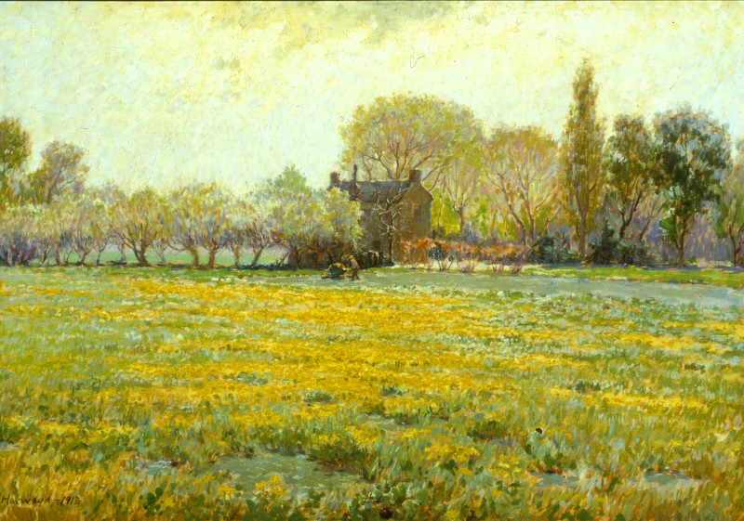
Gardening 101
“Keep your lawns and your gardens well-groomed. Whatever your circumstances, let your premises reflect orderliness, beauty, and happiness. Plan well and carry out your plan in an orderly and systematic manner.” Spencer Kimball

